Slide 1
Digital Image Processing Introduction (1)
Maulana Aziz Assuja

Slide 2
Outline
Introduction
Image Formation
Image Processing and Equalization
Color Correction
Convolution

Slide 3
Reference
Rafael C. Gonzales E.Woods, 2nd Edition,”Digital Image Processing Using Matlab”,Gates Mates Publishing,2009
Wanasanan Thongsongkrit,”Lecture Notes”
Richard Alan Peter, “Lecture Notes 2007“ ,http://www.archive.org/details/Lectures_on_Image_Processing
Richard Szeliski, “Computer Vision: Algorithms and Applications,23 April 2010

Slide 4
Image Processing?
Image Processing is sub part of Signal and Image Proessing
Goal : Enhance image quality perceived by human and computer
Image
Image Processing
Enhanced Image

Slide 5
Related Study
Computer Graphics : Create
Image Processing : Enhance, Manipulate
Computer Vision: Meaning, Information

Slide 6
Related Study (input and output)
Input | Output
 |  | Image | Description
 | Image | Image Processing | Computer Vision
 | Description | Computer Graphic | Data Mining

Slide 7
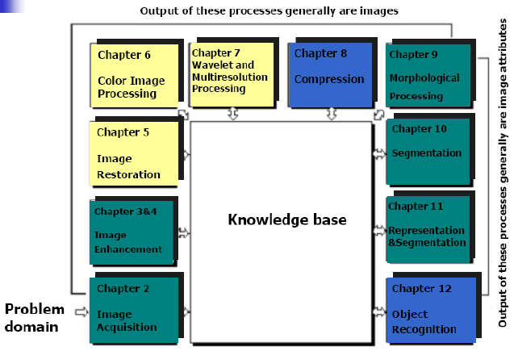
Fundamental Steps (Gonzales)

Slide 8
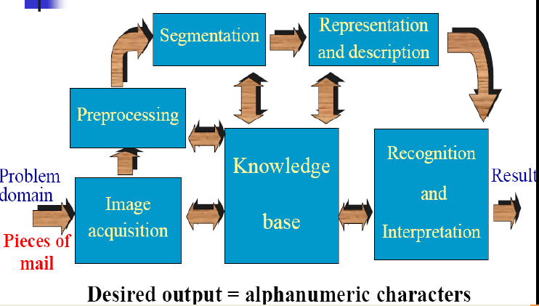
Ex : Postal Code Problem

Slide 9
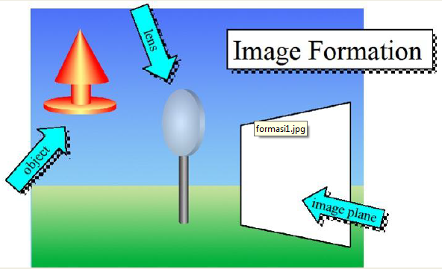
Image Formation

Slide 10
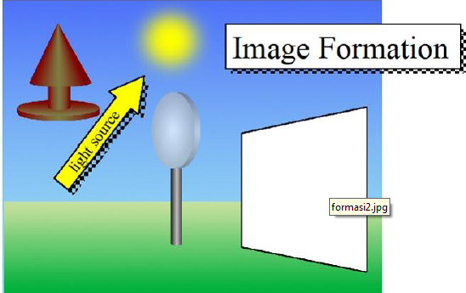

Slide 11
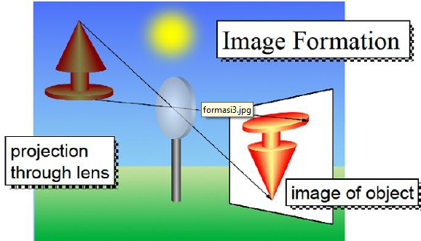

Slide 12
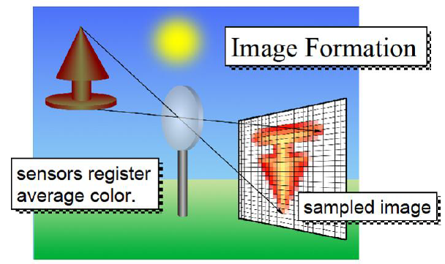

Slide 13
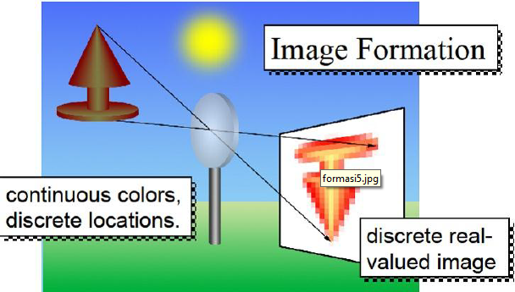

Slide 14
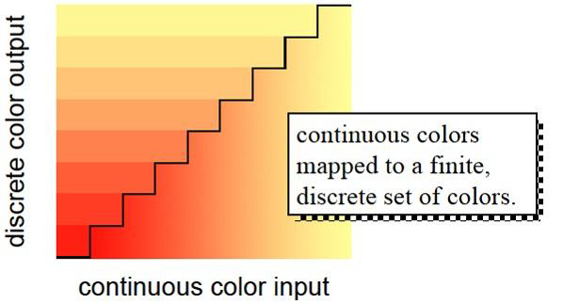
Quantization

Slide 15
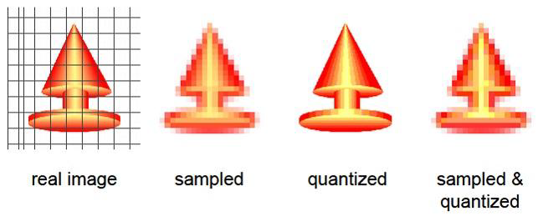
Sampling and Quantization

Slide 16
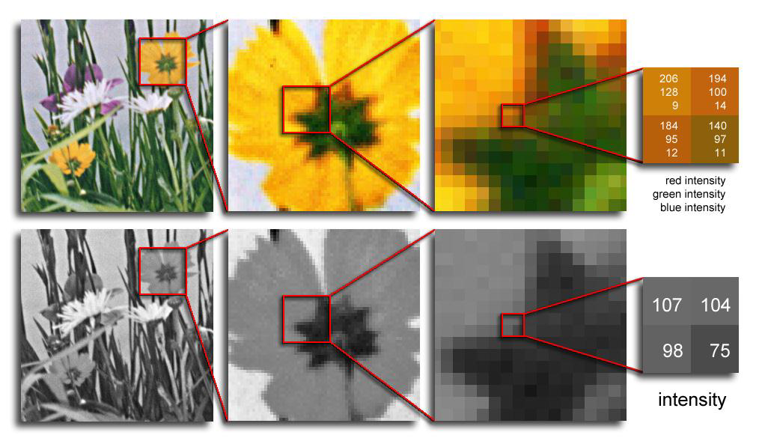
Digital Image Formation
Color images have 3 values per pixel
Monochrome images have 1 value per pixel
a grid of squares, each of which contains a single color
each square is called a pixel (for picture element)

Slide 17
Pixels
A digital image, I, is a mapping from a 2D grid of uniformly spaced discrete points,
{p = (r,c)},
into a set of positive integer values, {I( p)}, or a set of vector values, e.g., {[R G B]T(p)}.
At each column location in each row of I there is a value.
The pair ( p, I( p) ) is called a “pixel” (for picture element).

Slide 18
Pixels
p = (r,c) is the pixel location indexed by row, r, and column, c.
I( p) = I(r,c) is the value of the pixel at location p.
If I( p) is a single number then I is monochrome.
If I( p) is a vector (ordered list of numbers) then I has multiple bands (e.g., a color image).

Slide 19
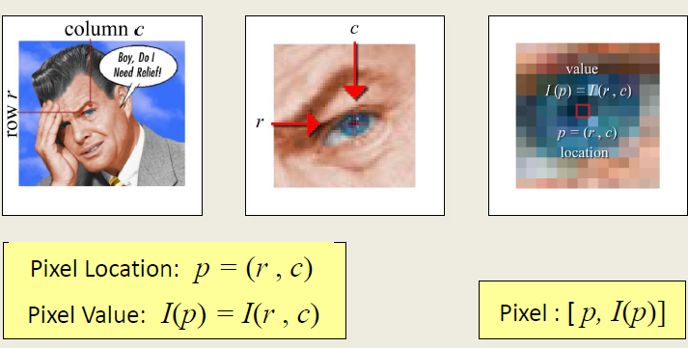
Pixels

Slide 20
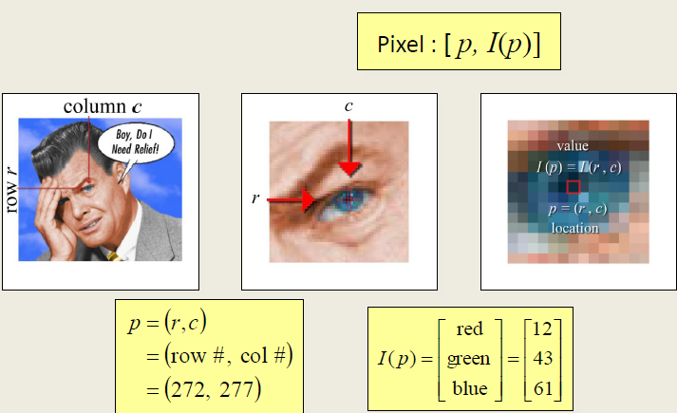
Pixels

Slide 21
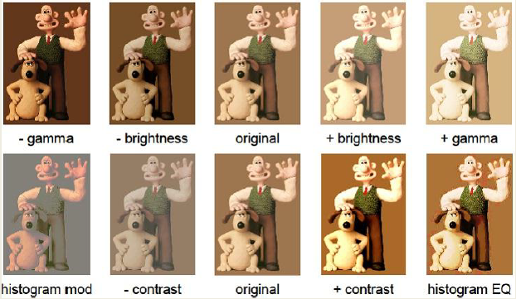
Point Processing

Slide 22
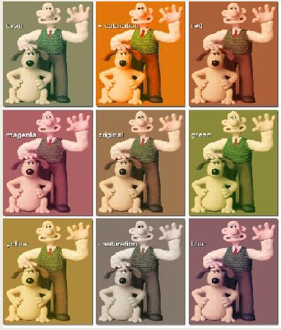
Color Correction

Slide 23
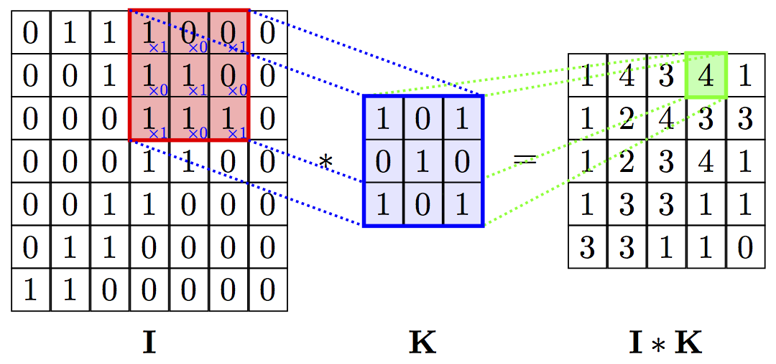
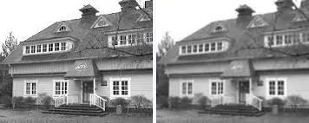
Convolution

